Slide 1

Automatic Transition From Client-Server to Peer-to-Peer Download
  Or, browsing the web slightly faster or possibly much faster.
  By: Roger Pack
Notes:
Moi

Slide 2

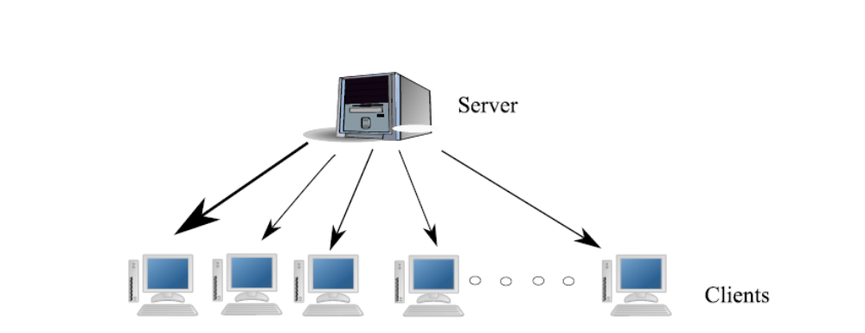
Problem
Traditional Client Server protocol tends to overwhelm the server.
Notes:
The incoming bandwidth is split N ways.
Common (anytime a server might be slow) slow bandwidth, large files, unexpected slash dot.

Slide 3
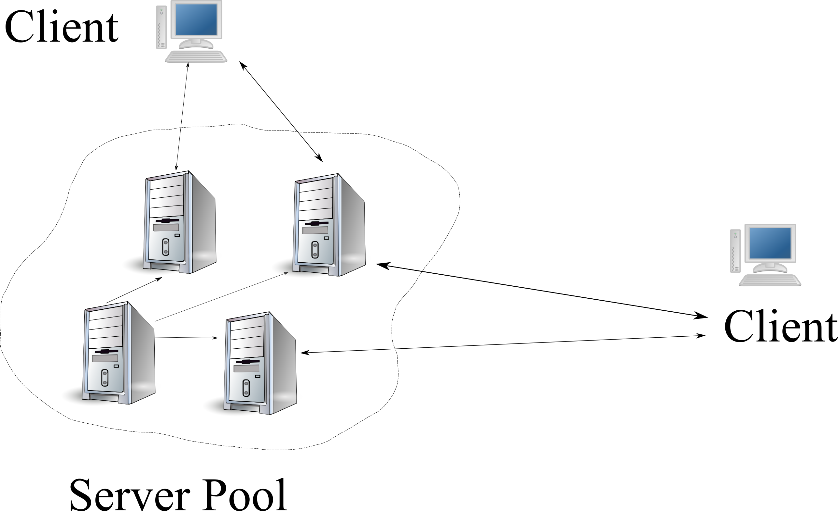
Alleviate it!
Mirrors/CDN
Notes:
Spreads the load among participants.
Expensive, or requires a lot of altruism. Still limited by the size of the CDN.
Obvious way to fix this is to have really fat pipes. Big incoming bandwidth. This is not always possible.

Slide 4
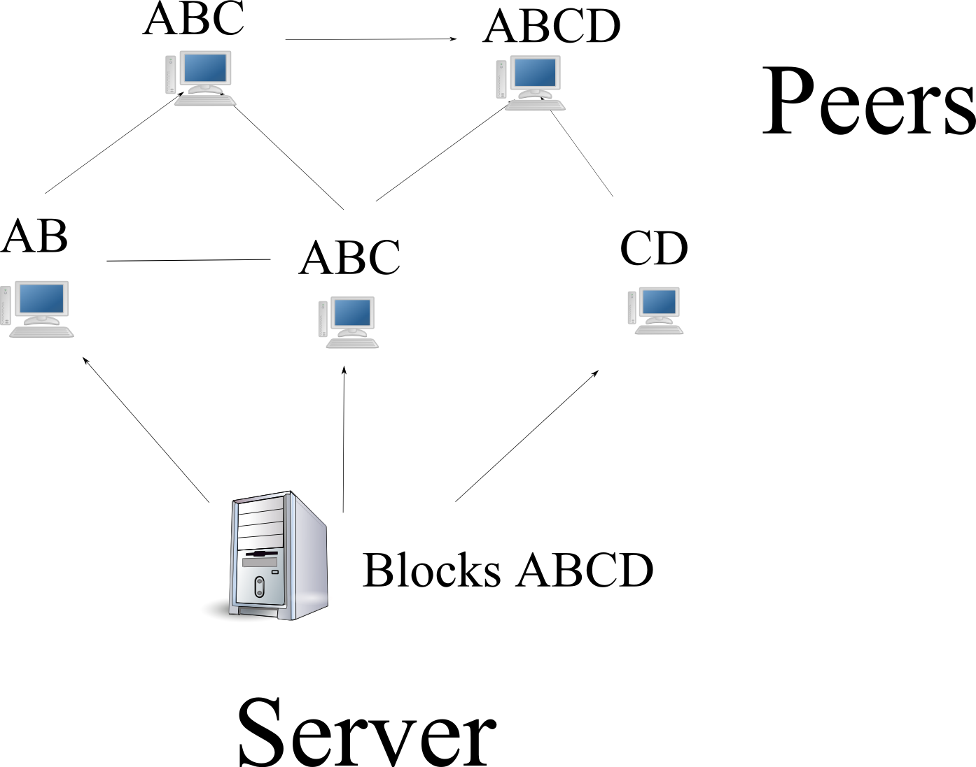
Peer-to-Peer downloading
Large Files
Notes:
Explain basic principle: peers receive distinct parts of the file, then trade amongst themselves. Thus relieving the file of having to serve all of the file to every peer.

Slide 5
BitTorrent
Steps to download:
1) Download .torrent file
2) Contact tracker for peers
3) Download blocks from peers, upload to others.
Notes:
BitTorrent does just this.

Slide 6
BitTorrent
Steps to download:
1) Download .torrent file
2) Contact tracker for peers
3) Download blocks from peers, upload to others.
Problems:
manual configuration
geared for large single files, not web site.
Notes:
Slow ramp up, single torrent for single files.
manual configuration
swarm = one file
(Is still centralized to get that .torrent file.)

Slide 7
Ideally...
All files
No configuration-Automatic transition from client-server to peer-to-peer.
Transparent to server.
Little infrastructure.
Notes:
Scalability of BitTorrent, but a more automatic system.
Benefits of each.

Slide 8
Thesis
A system of cooperating web clients can reduce load on a origin server by automatically switching between client-server file transfer and a peer-to-peer content delivery. This system can provide fast download times for objects of many sizes, equivalent in speed to BitTorrent for larger files, without requiring any manual configuration or participation from central web servers.

Slide 9
Proposed Solution
Build a peer-to-peer web browser.
Notes:
Overall...

Slide 10
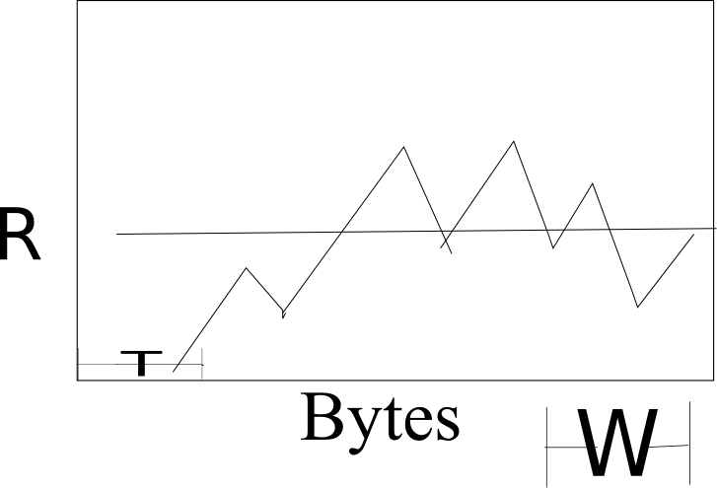
Solution plans
Step 1: Start a download.
Step 2: If slow, switch automatically to peer-to-peer downloading.
Notes:
Either starts too slowly, or it starts to lag in the middle of a download.

Slide 11
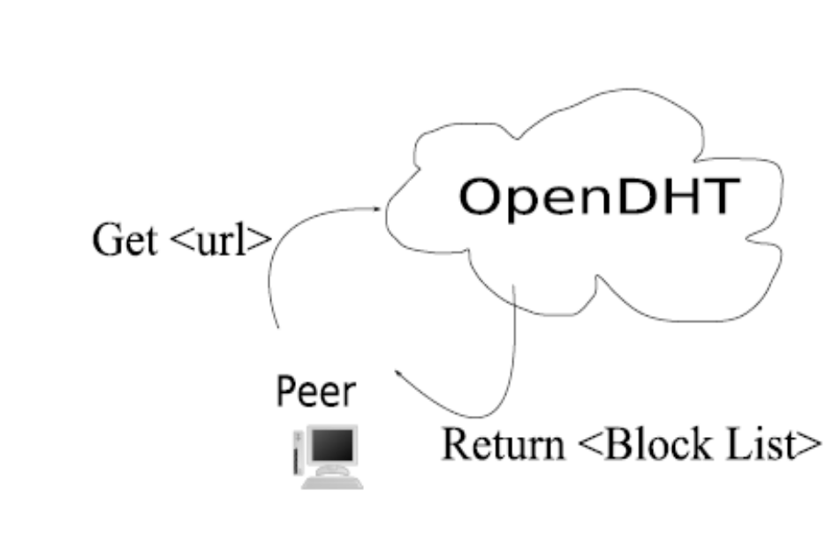
Solution plans
Step 1: Start a download.
Step 2: If slow, switch automatically to peer-to-peer downloading.
Step 3: Go to a DHT (internet wide distributed database), retrieve index block.
Notes:
Either starts too slowly, or it starts to lag in the middle of a download.
Will go to the DHT, and, based on the filename, will retrieve a list of the blocks of that file (or more especially, hashes of the contents of that block).

Slide 12
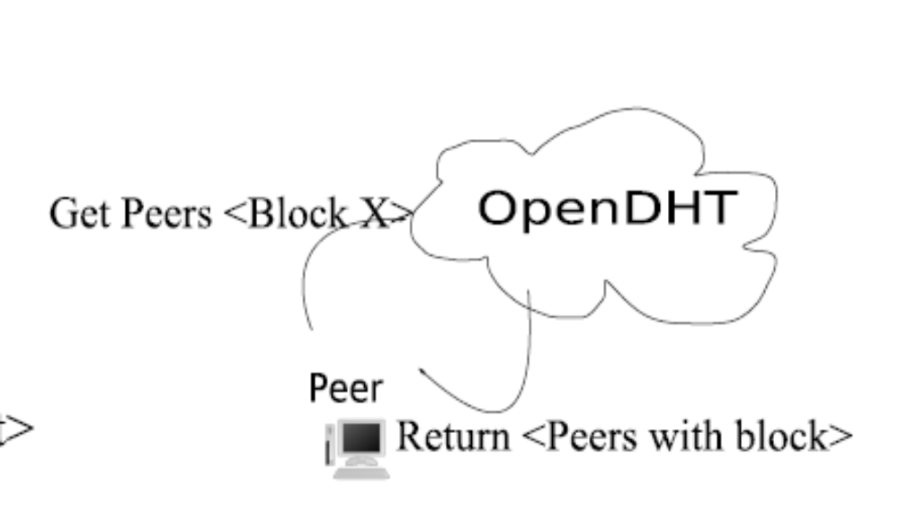
Solution plans
Step 4: Find peers that have that block.
Notes:
Either starts too slowly, or it starts to lag in the middle of a download.
Will go to the DHT, and, based on the filename, will retrieve a list of the blocks of that file (or more especially, hashes of the contents of that block).

Slide 13
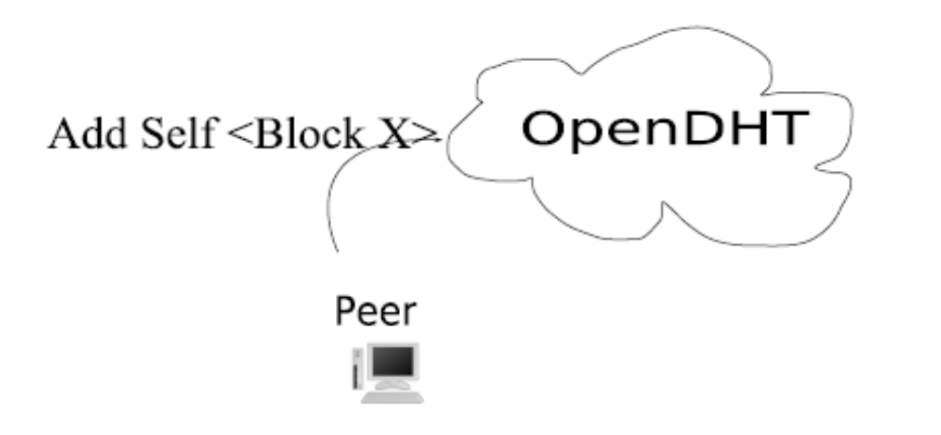
Solution plans
Step 4: Find peers that have that block.
Step 5: List yourself as new contributor for each downloaded block.
Notes:
Either starts too slowly, or it starts to lag in the middle of a download.
Will go to the DHT, and, based on the filename, will retrieve a list of the blocks of that file (or more especially, hashes of the contents of that block).

Slide 14
Benefits
Scalable
Automatic
Works for all files on a server
Transparent to server.
Transparent to user.
Non intrusive
Fast (hopefully)
Notes:
Scalable means no dedicated infrastructure.
Automatic = no user
Works for all files -> no configuration needed [small work?]
Transparent = no modification necessary
non-intrusive = [drawback is uploading, but this is only uploading things that we already downloaded—so that seems like an appropriate trade-off for users. psychologically easier to swallow].
“fast” -- good for us is that it withstands high load, so still successful if not fast.

Slide 15
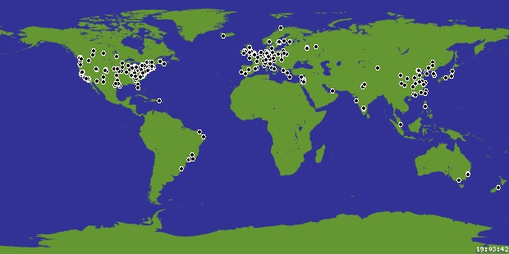
How to Test It
PlanetLab
Notes:
Single sign on, can use these all simultaneously for tests of a server.
Large scale, varied clients.

Slide 16
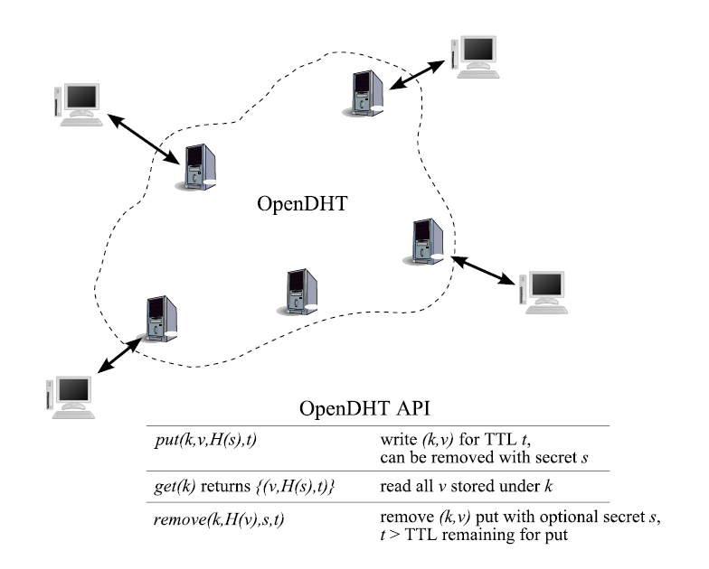
OpenDHT
Notes:
We need a rendezvous of the peers. A distributed DHT already exists on PlanetLab which can do scalable lookups for us. Clients can perform some set and get operations simply and easily and in a distributed manner. This will allow for easy experimentation and lookup of peers.

Slide 17
Experiments
Proof of Concept.
  Against trad. clients.
Automatic transition
  Vary T, then R, then W.
All files on the server
  File sizes? Multiple files?
Further optimizations?
Notes:
PoC against a typical web server, and to see at what point ours fails—to demonstrate scalability.
Then the parameters is to study parameters of the switching algorithm.
We will check to see if further optimizations will be necessary..
We may need to combat the slow last block problem or try to optimize based on locality between peers, or decrease load on th eserver 'explicitly.'

Slide 18
Metrics
Log all messages.
Origin Server
  Upload total bytes.
Clients
  Download times/rates, % from server –both decrease?
  Upload rates.
System throughput
Notes:
Clients should have faster download times.
System throughput should be high.

Slide 19
Contributions to the Field
Peer-to-peer web browser-
  First automatic transition from client-server to p2p downloading client protocol for all files on a web site.
Possibility for amazing speed increase.
Legitimate use of p2p.

Slide 20
Questions?
Notes:
Proof of Concept.
I think so.
I don't know until we test it. with optimizations I'd say yes, but I probably won't be doing too many of those—mostly proof of concept, working on the algorithm.

